Slide 1
CS3210 Tutorial 1
Parallel Computer Architecture and Slurm
Notes:
Prep:
Connect to soctfs
Have sacct_admin.sh
Run monitoring scripts to see the status of the class
Run watch -n 0.5 sudo squeue -a
Run watch -n 0.5 sudo sinfo

Slide 2
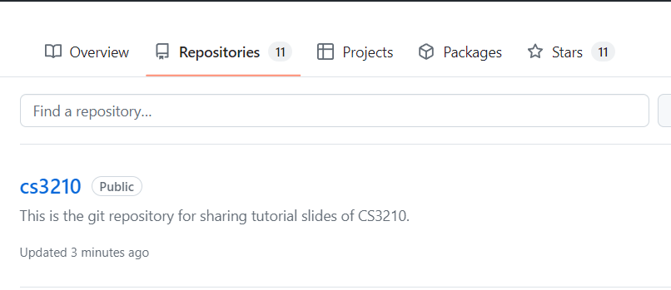
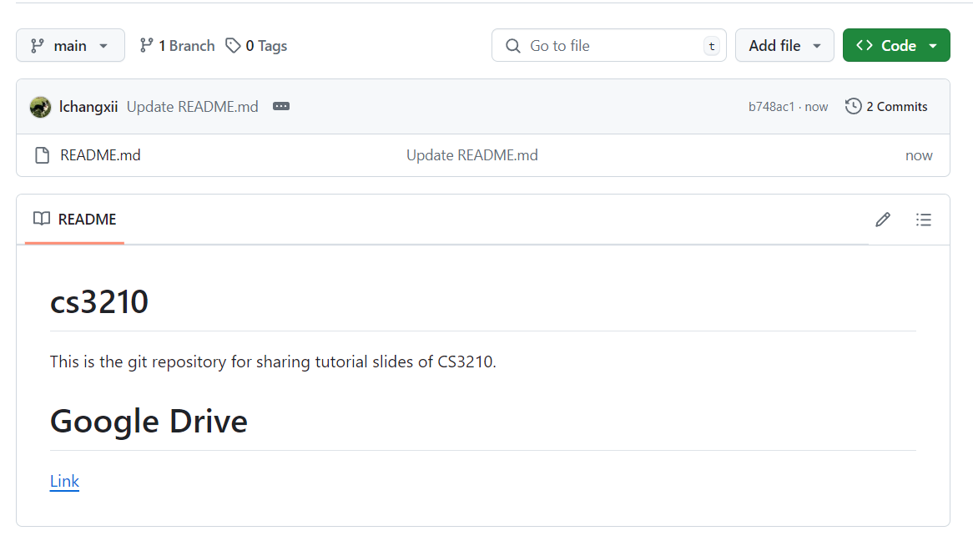
Questions and Slides Sharing
Slides
Github and Google Drive after every session.
https://github.com/lchangxii/cs3210
You can find the Link in the README if preferring Google Drive

Slide 3
So Far: High-Level
Processes and Threads (Lec 2)
Processes and Threads (Lab 1)
Parallel Computing Architectures (Lec 3)
Parallel Computing Architectures (Tut 1)
Process
Memory regions
fork/wait
IPC (Inter-process communication)
shared memory, message
Threads as lightweight processes
Users vs kernel threads
Synchronization: pthread mutexes, semaphores, condition variables
Forms of parallelism (bit/instruction/thread/processor)
Flynn’s Taxonomy (SISD/SIMD..)
Hierarchical vs Pipelined designs
How memory / cache is organized (distributed/shared/.. memory)

Slide 4
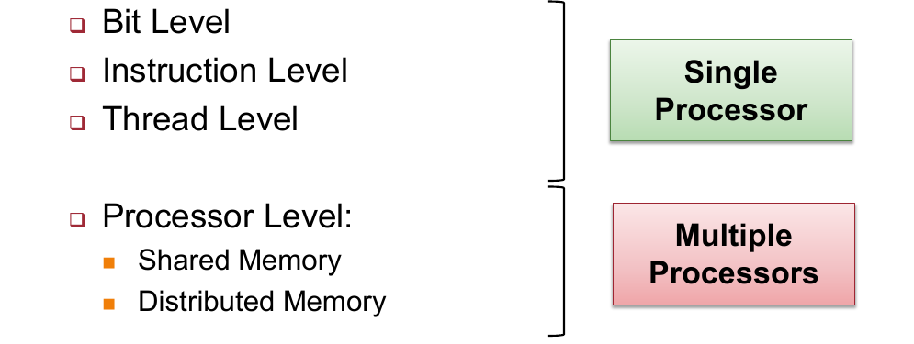
Focus: Forms of Parallelism

Slide 5
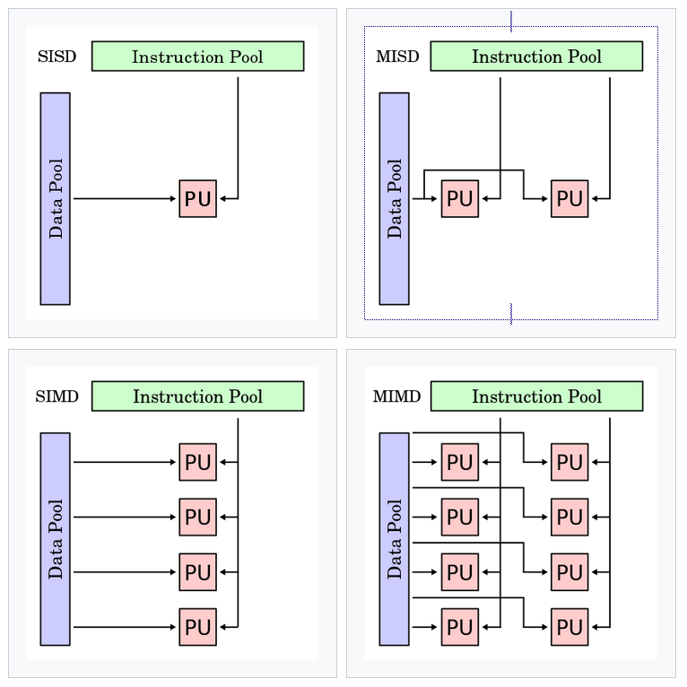
Focus: Flynn’s Taxonomy
Terminology to define different types of parallel architectures
Single / multi-instruction
How many independent streams of execution are there?
Single / multi-data
How many logical blocks of data are we trying to operate on?

Slide 6
Part 1: Tutorial Questions

Slide 7
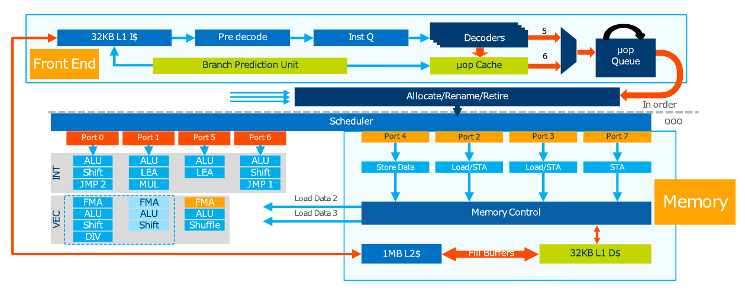
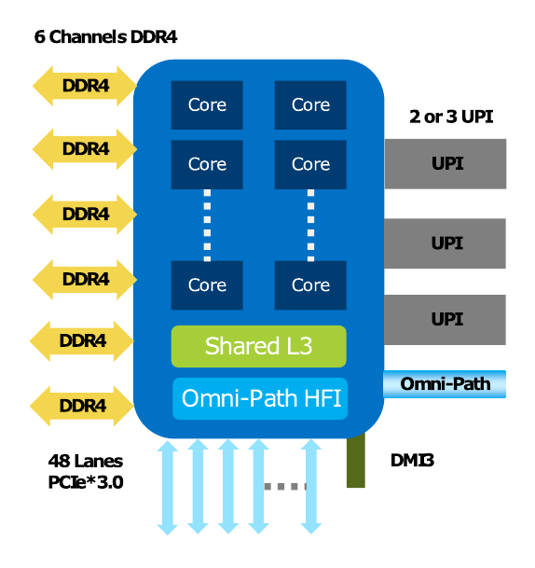
Q1: Identifying Forms of Parallelism
Determine where and how our processor supports parallelism
Don’t need to understand low-level details!
Googling should allow you to match Lec3 concepts to these “industry names”

Slide 8
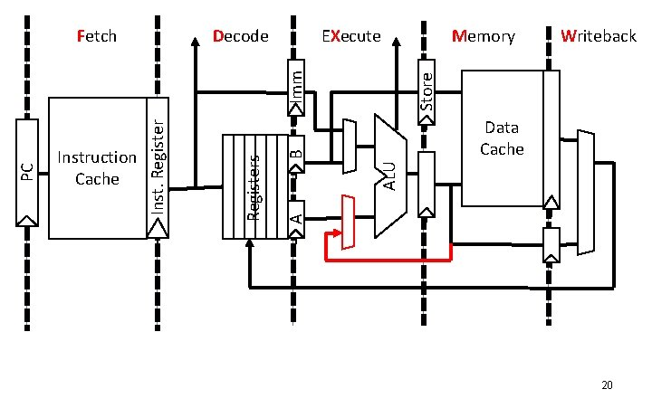
Q1: Mapping processors to CS2100
Decode
Fetch
Execute
Mem/WB

Slide 9
Q1: Identifying Forms of Parallelism
Where do we have instruction level parallelism? [p]

Slide 10
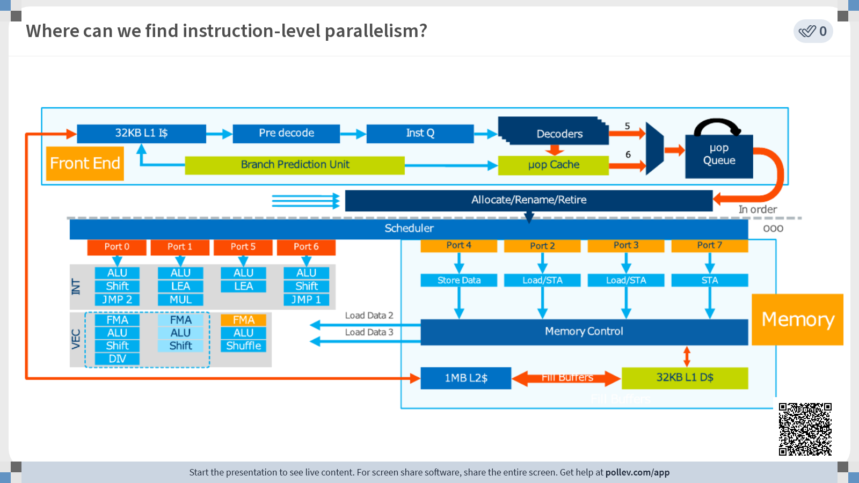

Slide 11
Q1: Identifying Forms of Parallelism
Where do we have instruction level parallelism?
One example of Superscalar processing: multiple duplicated parts of the processor pipeline

Slide 12
Q1: Identifying Forms of Parallelism
Where do we have thread level parallelism?

Slide 13
Q1: Identifying Forms of Parallelism
Where do we have thread level parallelism?
This entire diagram represents the pipeline for one core with 2 hardware threads! They share the resources in the core.

Slide 14
Q1: Identifying Forms of Parallelism
Where do we have processor level parallelism?

Slide 15
Q1: Identifying Forms of Parallelism
Where do we have processor level parallelism?
Each processor core runs individually: parallelism
Any more?

Slide 16
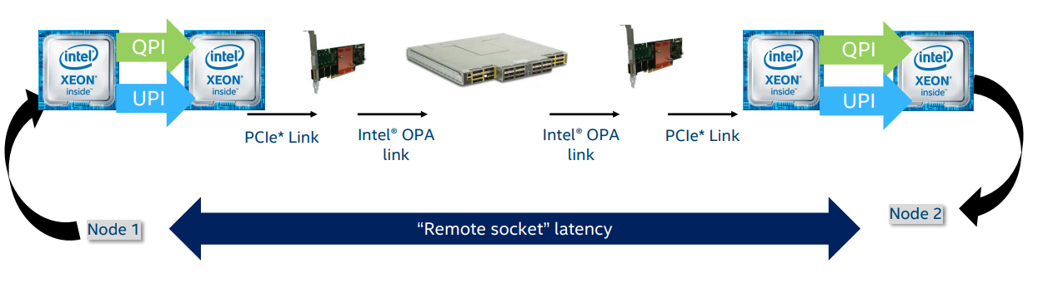
Q1: Identifying Forms of Parallelism
Where do we have processor level parallelism?
Intel UltraPath Interconnect (UPI): Processor to Processor (shared memory)
Intel OmniPath Architecture (OPA): Node to node (distributed memory)

Slide 17
Why does this matter?
When you run your code on certain hardware, you can make decisions about how to parallelize. Examples:
Node has multiple processors connected without high-speed interconnect? Maybe keep tasks to 1 processor.
Cores don’t have much superscalar ability? Maybe best to use simpler tasks over many cores.

Slide 18
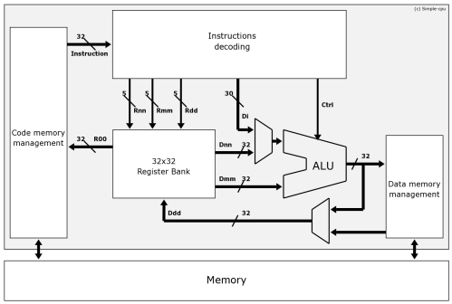
Q2: Flynn’s Taxonomy
What architecture for a personal computer from the 1980’s?
SISD: one instr and data stream

Slide 19
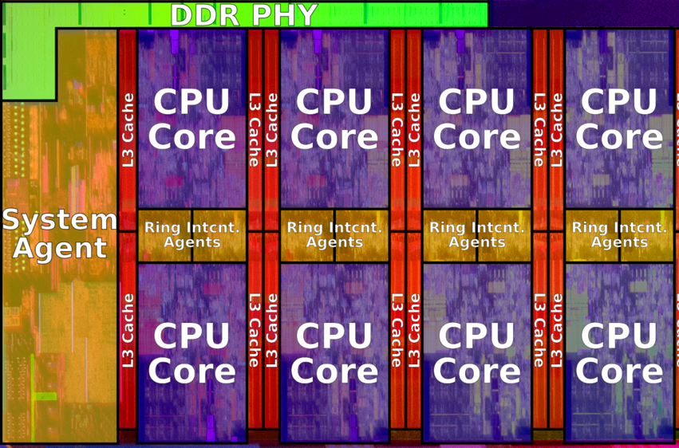
Q2: Flynn’s Taxonomy
What architecture for a multi-core processor laptop?
MIMD: Each core runs in parallel, independent data

Slide 20
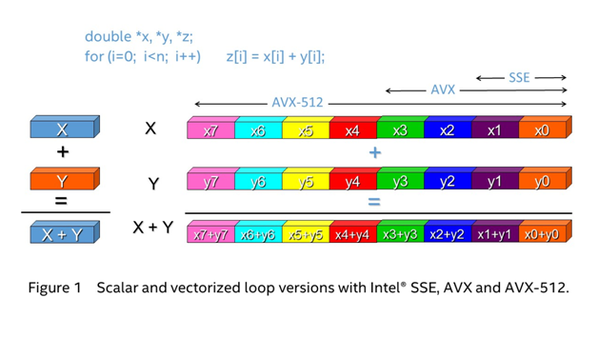
Q2: Flynn’s Taxonomy
What architecture for the Intel AVX instruction set?
SIMD: one instruction operates on multiple data blocks

Slide 21
Q2: Flynn’s Taxonomy
What architecture for a single core processor with pipelining?
SISD: same as first question

Slide 22

Q2: Flynn’s Taxonomy
Students in an exam hall?
MISD: same data (exam paper) but multiple independent streams (students)

Slide 23
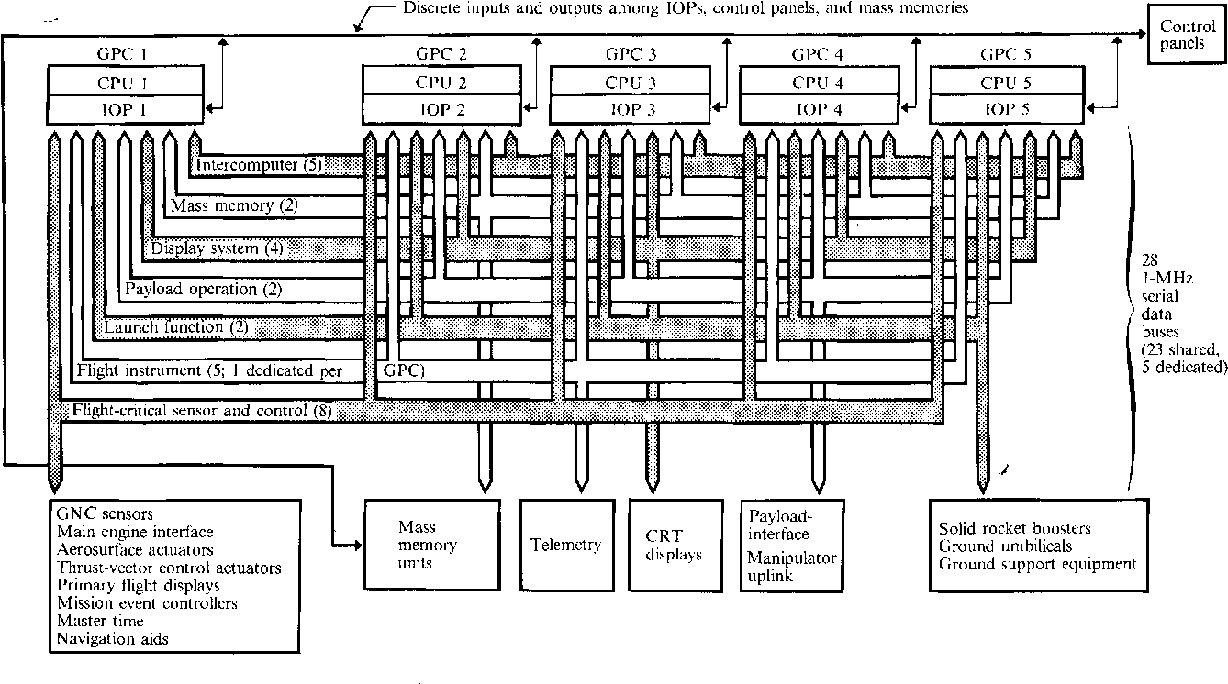
Interesting MISD: Space Shuttle CPUs
https://www.semanticscholar.org/paper/Redundancy-Management-Technique-for-Space-Shuttle-Sklaroff/eb225e9ad32eaeb29583ee0806d9381522de4959

Slide 24
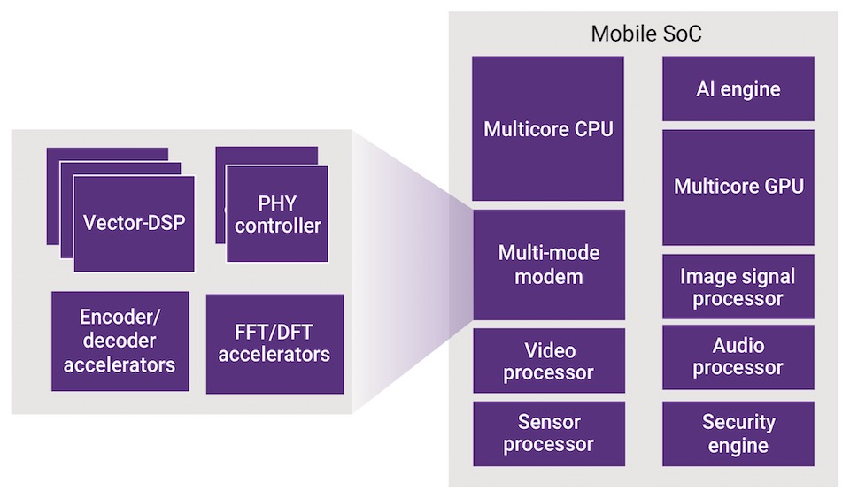
Why does this matter?
We see all kinds of specialized processors nowadays
Tradeoff between speed and generality
Taxonomies help us to understand the rough capabilities of new processing units

Slide 25
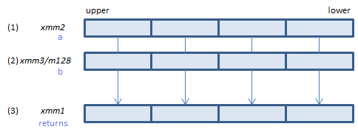
Quick look at AVX (SIMD) Instructions
Note - you don’t have to know details!
Just that such things (vector instructions) exist
https://godbolt.org/z/fbTeE4jb7
Guidebook: https://www.intel.com/content/www/us/en/docs/intrinsics-guide/index.html
vpaddd

Slide 26
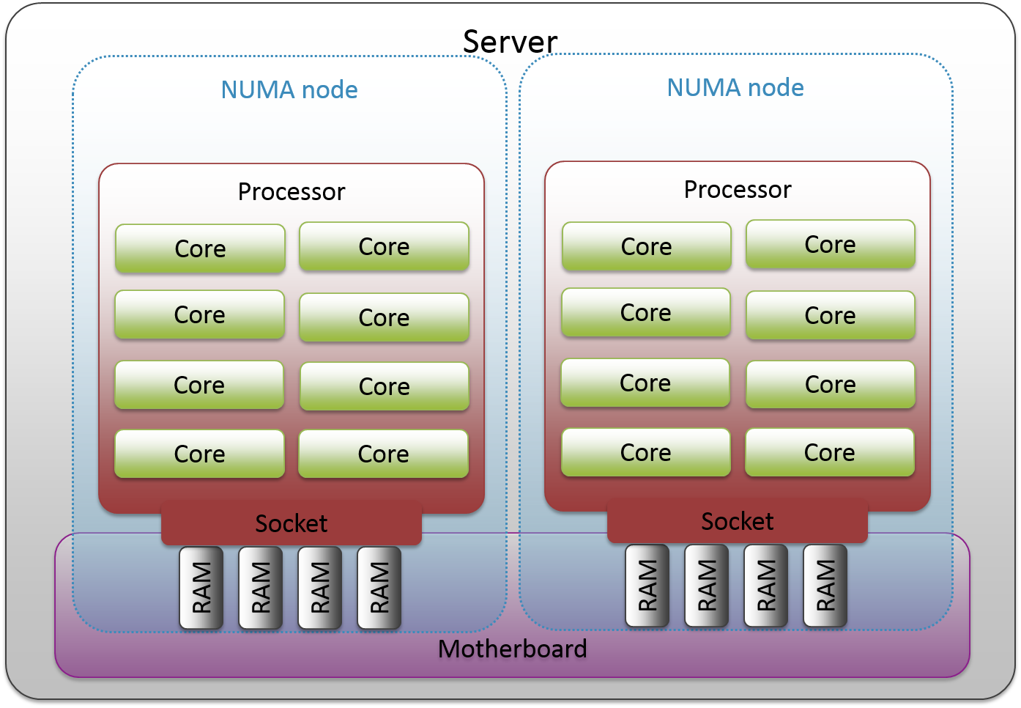
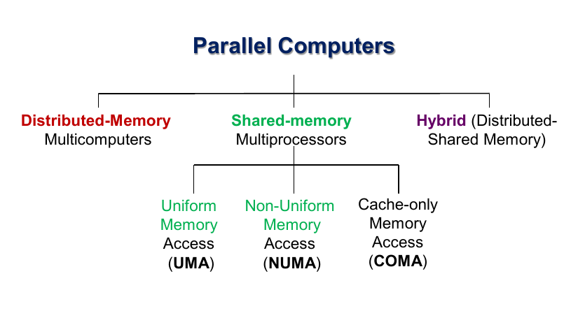
Q3: Memory & Multicore Architectures
Shared memory implies a UMA architecture? (T/F?)
No! Memory access need not be uniform!

Slide 27
Q3: Memory & Multicore Architectures
Answering Q2 at the same time: where your data is, is important in a NUMA architecture!

Slide 28
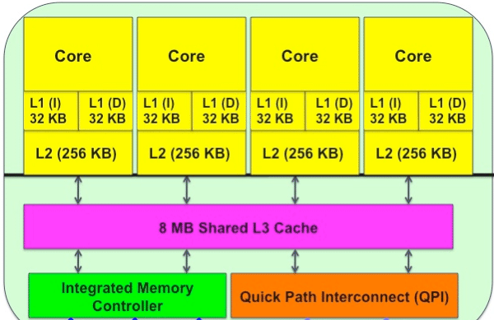
Q3: Memory & Multicore Architectures
In hierarchical multicore designs, is the memory organization hybrid (distributed + shared memory)?

Slide 29
Q3: Memory & Multicore Architectures
In hierarchical multicore designs, the memory organization is hybrid (distributed + shared memory)?
Both answers arguable!
Not hybrid: everyone just sees one shared memory
Is hybrid: could see cache as its own memory that can be out of sync

Slide 30
Why does this matter?
Understanding distributed / shared memory is crucial for fast parallel programs
Very small L1 caches? Your parallel programs may not benefit from accessing lots of individual data per core.
NUMA processors? Best to keep data organization in mind
A lot of performance can be squeezed out of good cache usage!

Slide 31
Q4: Processes and Threads
Can a semaphore replace a mutex without affecting correctness?

Slide 32
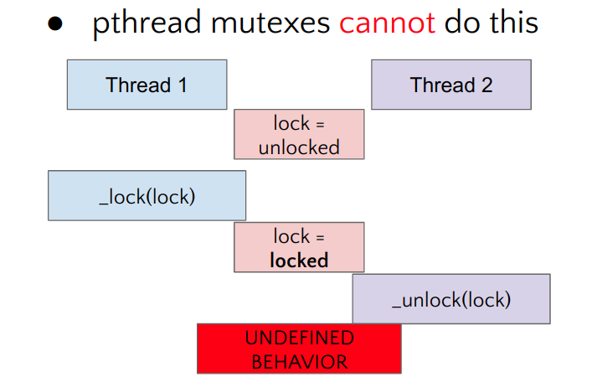
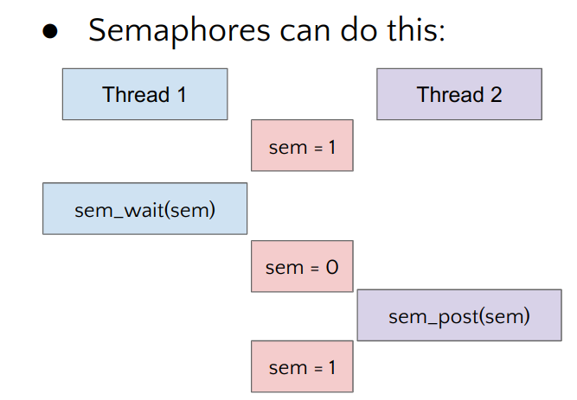
Q4: Processes and Threads
Can a semaphore replace a mutex without affecting correctness?
Yes! Semaphores are more general than mutexes, just set S = 1

Slide 33
Q4: Processes and Threads
Is a program implemented with threads faster than processes?

Slide 34
Q4: Processes and Threads
Is a program implemented with threads faster than processes?
Not necessarily, because:
Could be only user threads (mapped to 1 processor) – then it will be slower

Slide 35
Part 2 & 3: Practical Slurm Usage
Please follow at the same pace until later

Slide 36
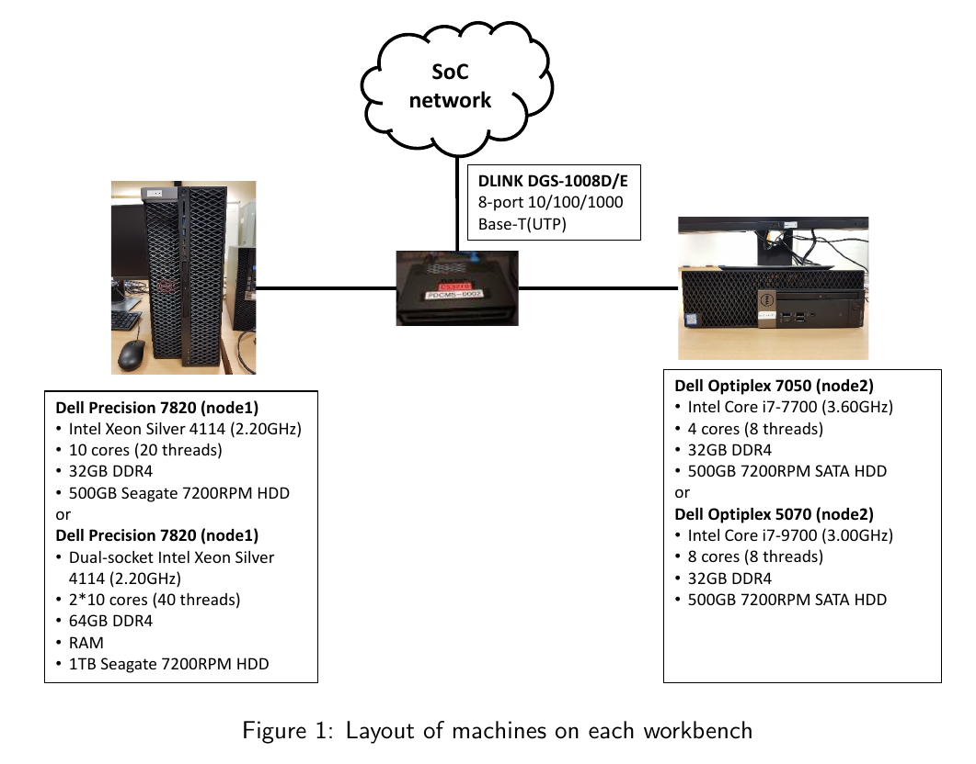
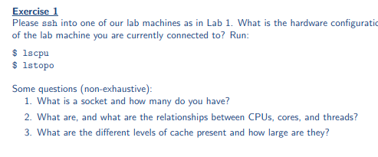
ex1: Login to a machine and run lstopo/lscpu
What’s the difference between sockets/cores/threads?

Slide 37
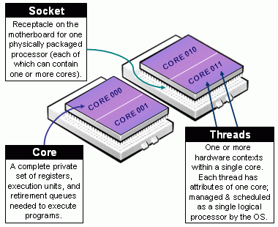
Socket vs Core vs Thread..
Thread: single hardware thread of execution
Core: single set of usable hardware for running code (registers, pipeline stages, some cache)
Cores * threads per core == lscpu CPUs → logical CPUs
Socket: where a full physical process fits (many cores)

Slide 38
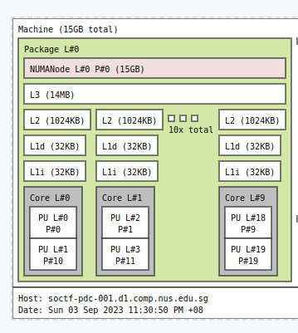
Understanding lstopo
lstopo --of svg>demo.svg
on your laptop:
scp EXXXXX@soctf-pdc-002.d1.comp.nus.edu.sg:~/demo.svg ./

Slide 39

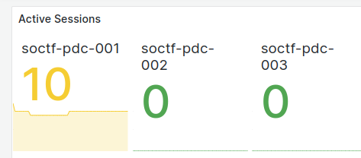
ex2: Lab Monitoring
Go to https://pdc.comp.nus.edu.sg/grafana
Login with your lab username and password
Click the “hamburger” menu on the top left side
Check out Home and Dashboards
Home - Overview of all nodes, including number of users logged in
“Sessions”
Login to nodes with fewer active sessions!
Dashboards - detailed “Node Exporter” dashboard

Slide 40
Introducing Slurm Workload Manager

Slide 41
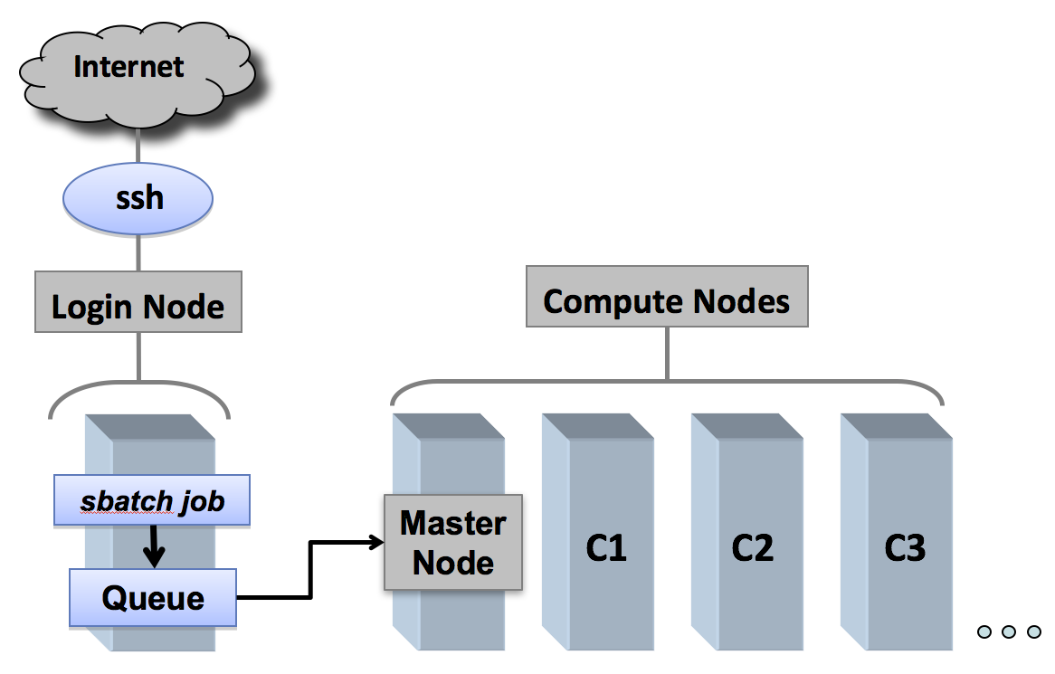
What is Slurm / Why Slurm?
Job allocation system
Fair allocation of compute resources
Exclusive access to nodes for performance measurements
Wide variety of machines to test on and run distributed programs on

Slide 42
Why Now?
SoC uses Slurm for our entire compute cluster
The best parallel computing systems use Slurm (>60% of TOP500)
Do not run long jobs on login nodes anymore!

Slide 43
Disclaimers
Please let us know if there are any issues (see tutorial for who to contact)
Our “best practices” and policies may change. Please refer to https://bit.ly/cs3210-student-guide for updates

Slide 44
Go forth and try!
ex3 - ex12: Small guided exercises working through the basics
ex13: Basic performance evaluation with Slurm
Please bring up any interesting observations!
For me:
watch -n 0.5 squeue
watch -n 0.5 sprio

Slide 45
Special Topics in Slurm: Priority and Share

Slide 46
Special Topics in Slurm: Priority and Share
Everyone run together: srun -w soctf-pdc-005 sleep 10
sprio -l
Who has more priority?
sshare -a
Who’s been using the most?

Slide 47
Special Topics in Slurm: Broad runtime statistics

Slide 48
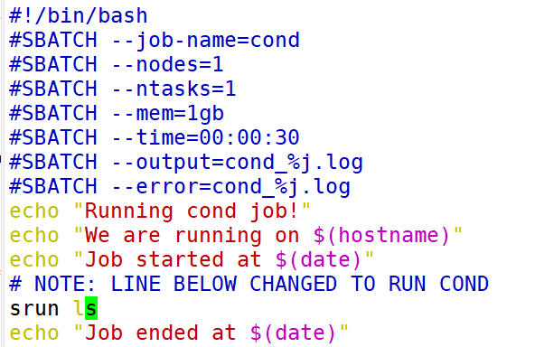
Special Topics in Slurm: Broad runtime statistics
You can find some information about running job statistics with sstat
sbatch cond.sh
sstat -o jobid,nodelist,ntasks,avecpu,averss,maxrss,maxdiskread,maxdiskwrite <jobid>

Slide 49
Special Topics: Sneak Peek At Performance Eval

Slide 50
Sneak Peek at Performance Evaluation
Are there hardware differences?
srun -p xs-4114 hyperfine ./pthread_addsub > xs4114.out
srun -p dxs-4114 hyperfine ./pthread_addsub > dxs4114.out
srun -p i7-7700 hyperfine ./pthread_addsub > i77700.out
srun -p i7-9700 hyperfine ./pthread_addsub > i79700.out
srun -p xw-2245 hyperfine ./pthread_addsub > xw2245.out

Slide 51
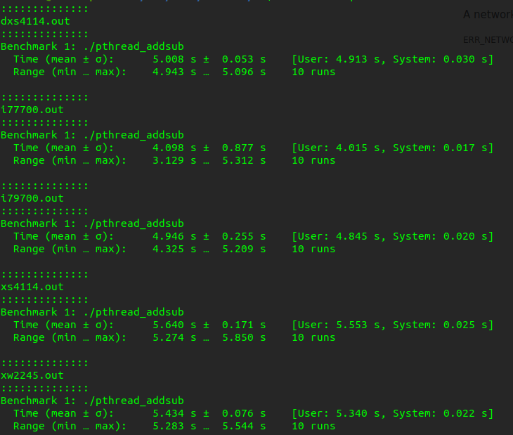
Processing the results

Slide 52
Results
8 core i7-7700 CPU @ 3.60GHz: 4.098s
8 core i7-9700 CPU @ 3.00GHz: 4.946s
20 core Xeon Silver 4114 @ 2.20GHz: 5.640s
20 core Dual-Socket Xeon Silver 4114 @ 2.20GHz: 5.008s
16 core Xeon W-2245 @ 3.90GHz: 5.434s
Notes:
The program is essentially single-threaded. All threads are adding to the same variable, so what matters is ultimately how fast each single thread in the CPU can go
xw:
Performance counter stats for './pthread_addsub' (3 runs):
4,358.36 msec task-clock # 0.953 CPUs utilized ( +- 1.64% )
4,040 context-switches # 898.337 /sec ( +- 0.64% )
323 cpu-migrations # 71.823 /sec ( +- 7.98% )
111 page-faults # 24.682 /sec ( +- 1.31% )
11,500,435,837 cycles # 2.557 GHz ( +- 0.18% )
6,046,566,089 instructions # 0.53 insn per cycle ( +- 0.00% )
2,009,196,286 branches # 446.766 M/sec ( +- 0.00% )
563,033 branch-misses # 0.03% of all branches ( +- 0.85% )
4.5735 +- 0.0721 seconds time elapsed ( +- 1.58% )
i77700
Performance counter stats for './pthread_addsub' (3 runs):
3,799.30 msec task-clock # 0.863 CPUs utilized ( +- 9.70% )
4,021 context-switches # 928.779 /sec ( +- 0.01% )
59 cpu-migrations # 13.628 /sec ( +- 13.75% )
115 page-faults # 26.563 /sec ( +- 0.50% )
10,958,218,455 cycles # 2.531 GHz ( +- 0.22% )
6,040,979,970 instructions # 0.55 insn per cycle ( +- 0.01% )
2,008,145,900 branches # 463.846 M/sec ( +- 0.01% )
928,683 branch-misses # 0.05% of all branches ( +- 1.56% )
4.403 +- 0.367 seconds time elapsed ( +- 8.33% )

Slide 53
Special Topics in Slurm: NFS

Slide 54
Special Topics in Slurm: NFS
Your home directory: /nfs/home/username is a network filesystem (NFS) between all nodes
How much slower is NFS than node-local storage?
dd if=/dev/zero of=/nfs/home/exxxxx/test.img bs=100MB count=1 oflag=dsync
dd if=/dev/zero of=/tmp/test.img bs=100MB count=1 oflag=dsync

Slide 55
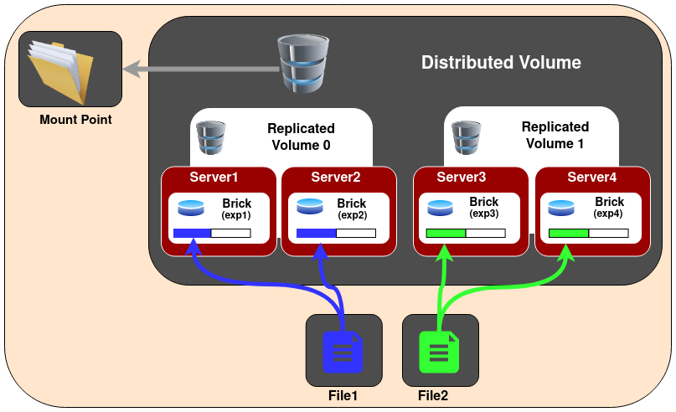
Special Topics in Slurm: NFS
We run a distributed + replicated NFS with “GlusterFS”
4 servers (17/22/23/24), each server has half the files.
Tolerates loss of 1 server, maybe 2.

Slide 56
Summary
Parallel architectures
Flynn’s taxonomy
Memory, Processes vs threads
Slurm usage

Slide 57

Attendance
or link

Slide 58
See you next week!
Email: changxi_liu@nus.edu.sg

